Slide 1
Stephen Heller Project Director, InChI Trust Chairman, IUPAC Division VIII InChI subcommittee Guest Research NIH/NLM/NCBI/PubChem Project
A Short History of the InChI Project

Slide 2
InChI Timeline (Part 1) ~ 1970/72 NIH Mass spectral database initiated ~ 1973/74 NIH/EPA Mass spectral database ~ 1975 CAS Registry Numbers contract ~ 1980 EPA transfers database to NBS/OSRD ~ 1978-1983 NBS/OSRD 5 Volume + 2 supplemental volumes of mass spectra ~ 1985/88 NIH/EPA/NIST mass spectral database ~ 1998 CAS contract not renewed ~ 1999 InChI project conceived ~ 2000 IUPAC conference/request for NIST to assist

Slide 3
Date: Mon, 15 Nov 1999 18:48:30 -0500 (EST) From: Stephen R. Heller<srheller@cliff.nal.usda.gov> To: stein <sstein@enh.nist.gov> Subject: Re: A strawman proposal Steve- First rough draft. Let's talk tomorrow about it. Steve -------------- 11/15/99 An IUPAC Chemical Registry System In response to the upcoming March 2000 IUPAC meeting - Representations of Molecular Structure: Nomenclature and its Alternatives - I would like to propose the creation of an IUPAC public domain chemical registry system.

Slide 4
InChI Timeline (Part 2) ~ 2005 InChI version 1 released ~ 2008 First release of the hash InChIKey ~ 2009 Release of standard InChI which took the original algorithm with its many variable parameters and fixed them so that interoperability between databases and resources with InChIs could be achieved. ~ 2009 InChI Trust was formed Not for profit charity in the UK ~ 2011 Version 1.04 released ~ 2011 InChI Certification Suite - designed to check the correct installation of the InChI software ~ 2017 Version 1.05 released ~ 2017 Version 1.00 of the Reaction InChI (RInChI) released ~ 2021 Version 1.06 released

Slide 5
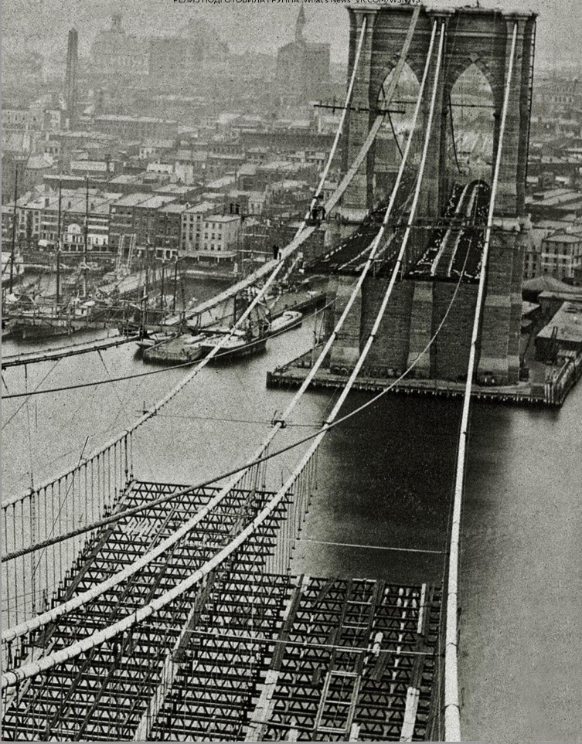
\

Slide 6
InChI layered structure design
The current InChI layers are:
1. Formula
2. Connectivity (no formal bond orders)
a. disconnected metals
b. connected metals
3. Isotopes
4. Stereochemistry
a. double bond (Z/E)
b. tetrahedral (sp3)
5. Tautomers (on or off)
Charges are added to end of the string
The InChI Algorithm normalizes chemical representation and includes a “standardized” InChI, and the ‘hashed’ form called the InChIKey

Slide 7
“Standards are like toothbrushes – everyone has one but no one wants to use someone else's.” Phil Bourne, Former Associate Director for Data Science (Big Data), NIH

Slide 8
InChI is the worst computer readable structure representation except for all those other forms that have been tried from time to time. With apologies to Sir Winston Churchill (House of Commons speech on November 11, 1947)

Slide 9
InChI subcommittee Working Groups Mixtures Monomer Atoms Variability/Positional Isomers Nanomolecules Isotopologues Resolver Reactions Organometallics/Inorganics Large Molecules Extended Tautomers QR Codes Education/Academic/Training (OER) Extended Stereochemistry GitHub

Slide 10
Large Real Databases with InChIs/InChIKeys EBI UniChem –157 million NIH/NCI/CADD/iRL–133 million NIH/PubChem -97 million RSC/ChemSpider –71 million Elsevier/Reaxys –31 million IUPAC –0 million Virtual Databases with InChIs/InChIKeys GDB17 –166 Billion NIH/NCI/Argonne/SAVI –4 Billion

Slide 11
InChI Videos
1. What on Earth is InChI?
http://www.youtube.com/watch?v=rAnJ5toz26c
2. The Birth of the InChI
http://www.youtube.com/watch?v=X9c0PHXPfso
3. The Googlable InChIKey
http://www.youtube.com/watch?v=UxSNOtv8Rjw
4. InChI and the Islands
http://www.youtube.com/watch?v=qrCqJ0o4jGs

Slide 12
Acknowledgements (Current and past members for the IUPAC InChI subcommittee and associated InChI working groups – 3/21) Steve Bachrach, Colin Batchelor, John Barnard, Bob Belford, Evan Bolton, Ray Boucher, Steve Boyer, Ian Bruno, Steve Bryant, Alex Clark, Szabolcs Csepregi, Rene Deplanque, Josef Eiblmaier, Vincent Scalfani, Jeremy Frey, Nicko Goncharoff, Jonathan Goodman, Guenter Grethe, Richard Hartshorn, Elena Herzog, Jaroslav Kahovec , Richard Kidd, Hans Kraut, Alexander Lawson , Peter Linstrom, Iselut Lynch, Gary Mallard, Leah McEwen, Bill Milne, Hunter Moseley, Moss, Peter Murray-Rust, Heike Nau, Marc Nicklaus, Carmen Nitsche, Matthias Nolte, Steffen Pauly, Igor Pletnev, Josep Prous, Peter Murray-Rust, Hinnerk Rey, Ulrich Roessler, Adam Sanford, Roger Schenck , Martin Schmidt, Steve Stein, Peter Shepherd, Markus Sitzmann , Chris Steinbeck, Keith Taylor, Dmitrii Tchekhovskoi, Bill Town, Wendy Warr, Jason Wilde, Tony Williams, Andrey Yerin, Shuli You. Special Acknowledgement: Ted Becker& Alan McNaught for their vision and leadership of the future of IUPAC nomenclature.

